Slide 1
Problem set 04
Question 1
Filter

Slide 2
Problem Statement
Greyscale
Sepia
Reflect
Blur

Slide 3
Greyscale
RGB
Same higher of R,G,B value is closer to black
Same lower value of R,G,B closer to white
Conclusion : give average same value to Red, Green and Blue to get GREYSCALE

Slide 4
Sepia
sepiaRed = .393 * originalRed + .769 * originalGreen + .189 * originalBlue
sepiaGreen = .349 * originalRed + .686 * originalGreen + .168 * originalBlue
sepiaBlue = .272 * originalRed + .534 * originalGreen + .131 * originalBlue

Slide 5
Reflect
Swap array values
First value with the last and so on
Run loop to Width/2

Slide 6
Blur
Find average R,G,B of neighbors.
Then give Red average to output red and perform same with blue and green

Slide 7
Question 2
RECOVER images

Slide 8
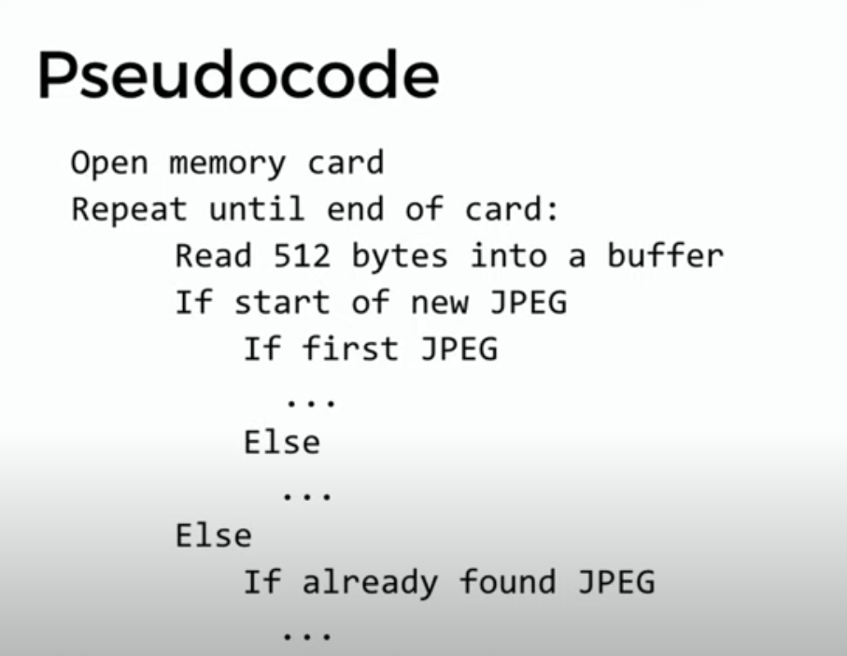
Pseudocode

